Slide 1


Texas Hold 'em AI Player Design
Yung-Jen Cheng, Peiheng Hu, Sail Wu, Xide Xia
AM207 Advanced Scientific Computing: Stochastic Optimization Methods
Spring 2015

Slide 2
Introduction - Poker, Texas hold 'em
Motivation:
A game of imperfect information
Possible to derive deterministic probability of a given hand from simulation
Find the way player react and the psychological components involved is hard
Goal:
Implement a system to make optimal playing strategy by modeling the style of the player
Obtain observations of the style of the player
Update the style of the player to play in the game

Slide 3
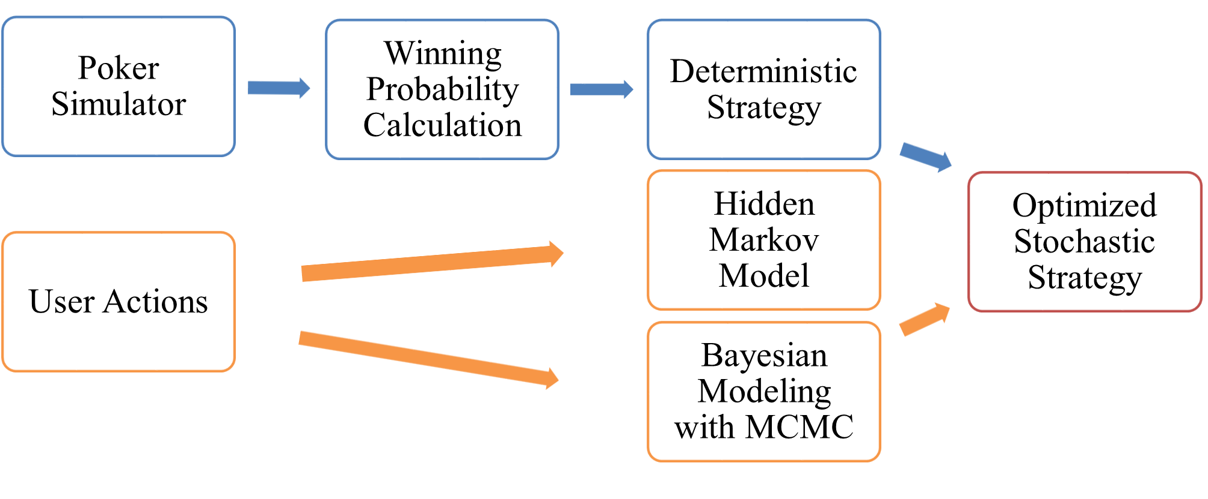
Approach – Deterministic and Stochastic Combination

Slide 4
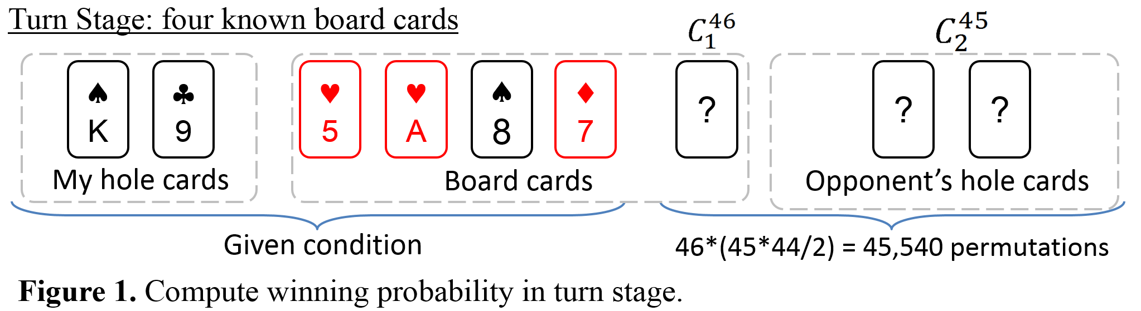
Winning Probability
The winning probability is calculated through permuting all possible opponent's hole cards and count winning times given your hole cards and the known board cards.
The winning probability needs to be calculated for all three stages, Flop, Turn and River.

Slide 5
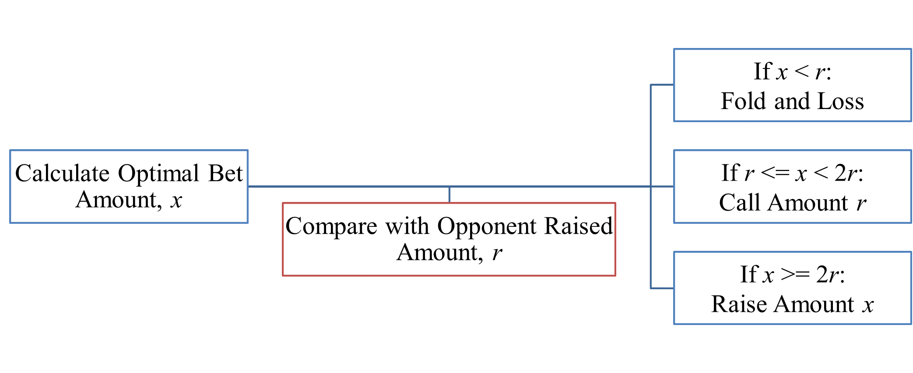
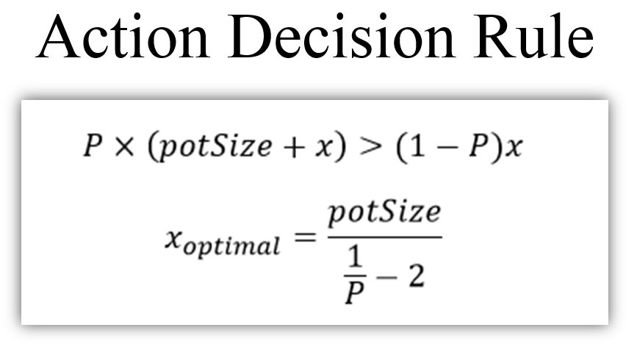
Deterministic Model
With the probability of winning computed from permuting all the combinations, a fixed/deterministic strategy can be deduced.
Scenario 1 winning probability > 0.5: Raise according to the hand strength
Scenario 2 winning probability < 0.5:

Slide 6
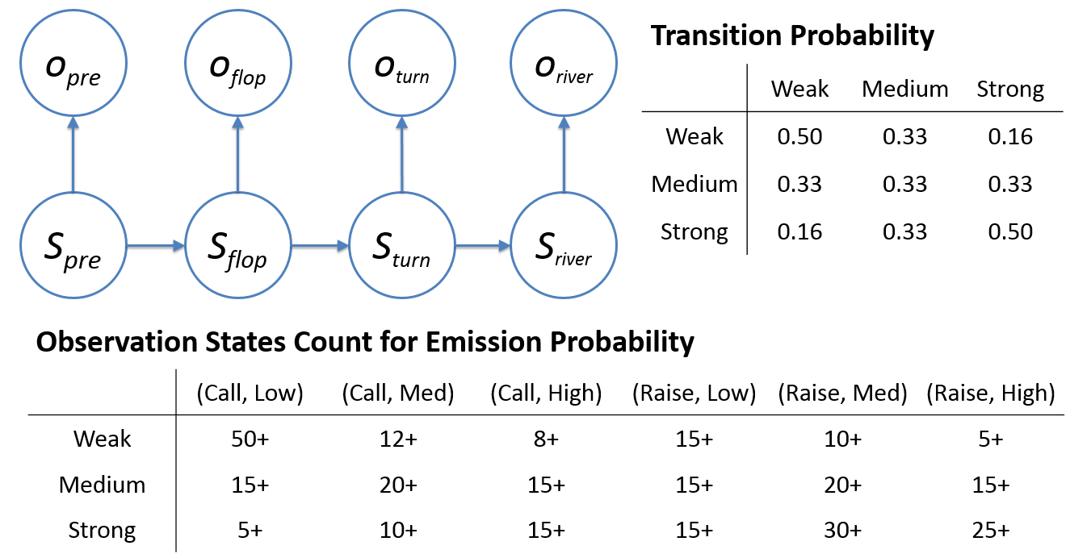
HMM Hand Strength Estimation

Slide 7
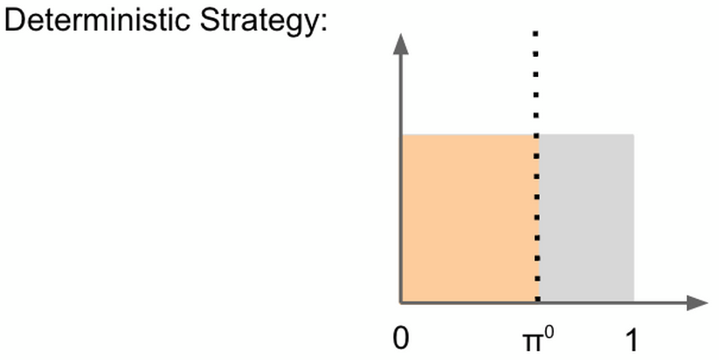
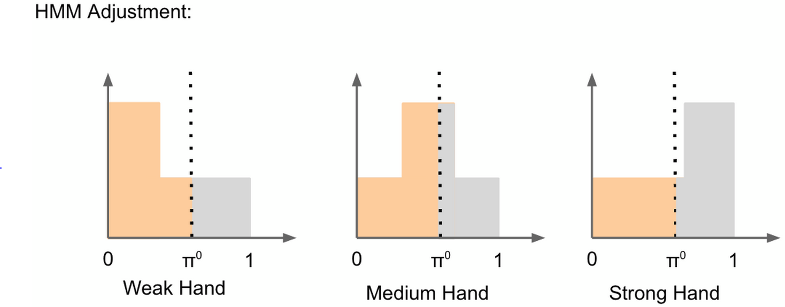
Deterministic & HMM Integration
Deterministic calculation shows the winning probability is which equals to the shaded area to the left of π⁰.
The adjustment of winning probability π⁰ calculated based on one of the three states below.

Slide 8
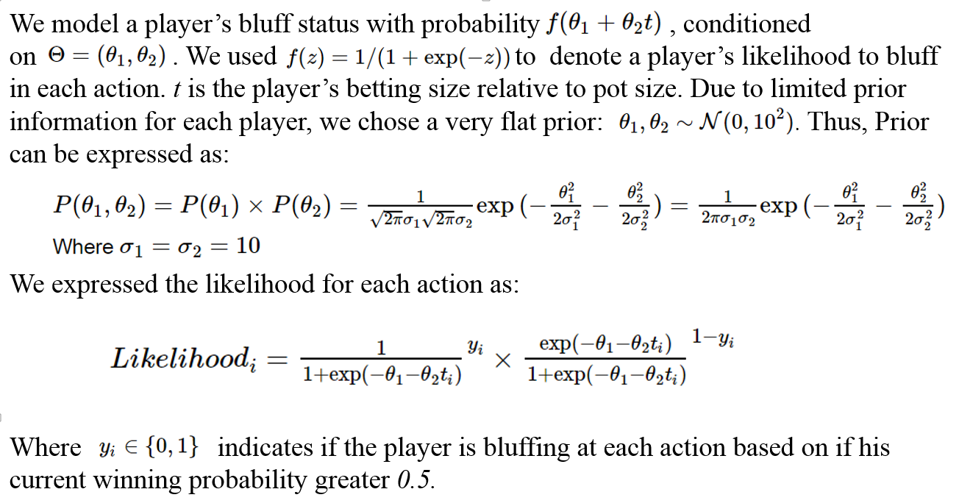
Bluff Tendency Bayesian MCMC Estimation

Slide 9
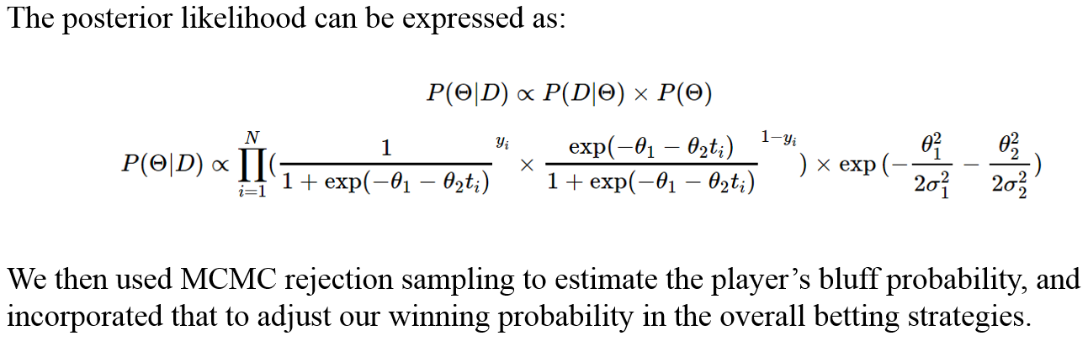
Bluff Tendency Bayesian MCMC Estimation

Slide 10
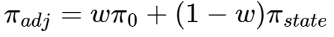
Deterministic & Bluff Tendency Integration
We also believe that if the opponent has a higher probability to bluff, we will be less certain about the results from HMM estimation and rely more on the uniform distribution.
Thus, the adjusted winning probability will be:
Where ω is the opponent's probability to make bluff.

Slide 11

Conclusions
Novel approach to mimic human player’s betting patterns
Successfully integrate both deterministic and Bayesian approach to form betting decisions
Unlike other conventional game simulators, our software does not requires intensive training time

